Slide 1


Quantum Computing Novices attempt to Program Universal Shor’s Algorithm
George Oliynyk, Owen Ungaro, Sameer Sethuram
The Lion

Slide 2

About
Us
Sophomore CS Undergraduate Majors @ Stevens Institute of Technology

Slide 3
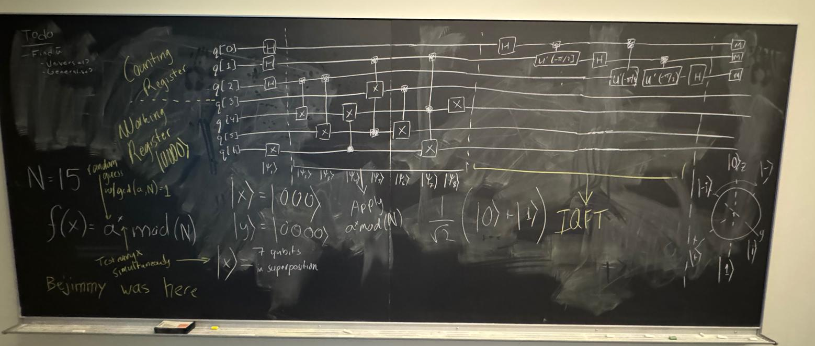
Project Timeline
Q1 12pm - 3pm
Q2 3pm - 12am
Q3 12am - 9am
Q4 9am-12pm
Getting Started
Quantum Learning
Shor’s Algorithm
Finishing Touches
Learn about the prompt.
Analyze where we stand as a group.
Setup QuantumRings and Qbraid.
Introductory quantum computing courses.
Note-taking.
Toying around with Qbraid and Qiskit.
Using Qbraid and Qiskit, attempt to program Shor’s Algorithm.
Employed LLMs to further comprehension.
Attempted to reverse engineer example algorithm.
Touching up / tweaking our algorithm.
Creating presentation and DevPost.
Submitting our final product.

Slide 4
Universal Shor’s Algorithm Results

Slide 5
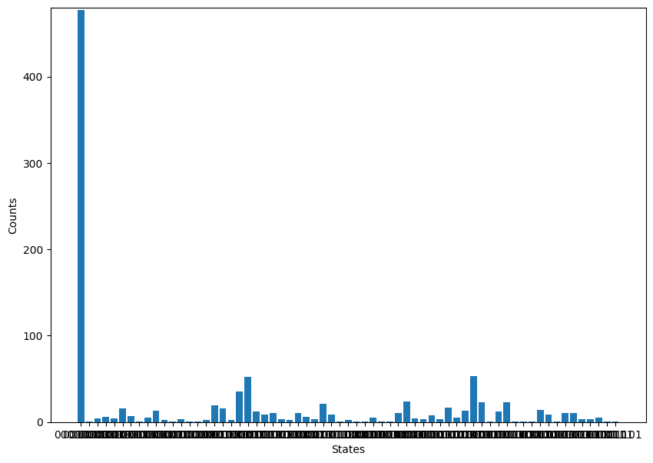
Graph of States vs Counts
This example graph depicts the best m value for finding the period r for a given number N. By excluding 0 and all odd r values calculated from m, we can effectively find the factors, p and q, of N through r!

Slide 6
It Doesn’t Work!

Slide 7
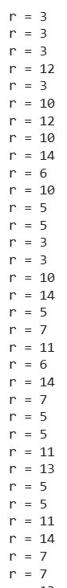
What went wrong?
We wish we knew… but from the data that we received from our Universal Shor’s algorithm, we concluded that our algorithm was giving us r values that plainly did not work.
Due to our general lack of knowledge in the field of quantum computing, troubleshooting and finding the root cause of the algorithm’s failure was difficult to find and resolve, and so our model failed… kind of…

Slide 8
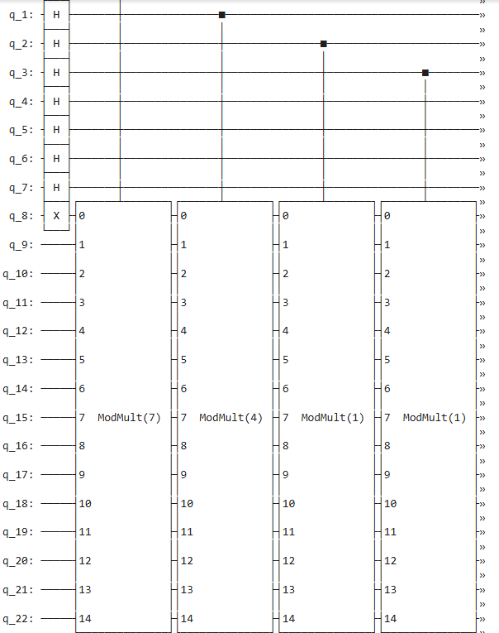
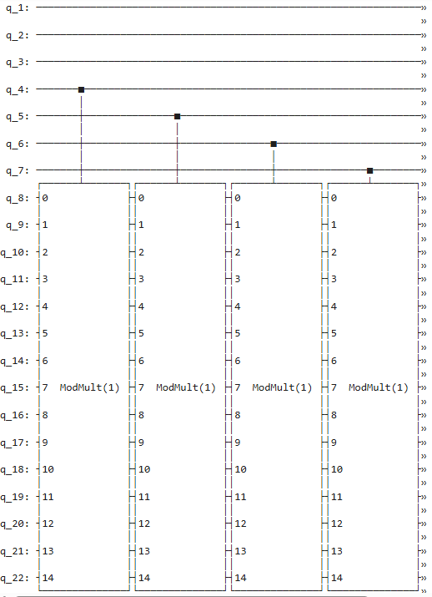
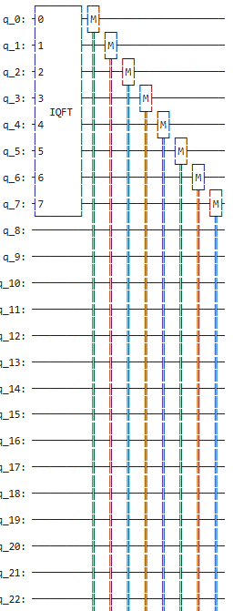
How we Cope with Failure
The algorithm itself doesn’t work at all, so what does?
Reading the states of the Qubits
Applying quantum gate operations on the Qubits.
Reading the phase of the Qubits using the Inverse Quantum Fourier Transformation.
As complete beginners in the field of quantum computing, this is a huge win and a wonderful learning experience for us.

Slide 9
Thank you to QuantumRings and YQuantum!
For the enriching and hands-on learning experience!

